Slide 1
COVID-19 Hackathon: Comparing different models
Exploratory Data Analysis
LightGBM
Logistic Regression
Random Forest
XGBoost
HistCBC
Summary
Ivan
Bhaskara-Rao
Hieye
Loic
Luke

Slide 2
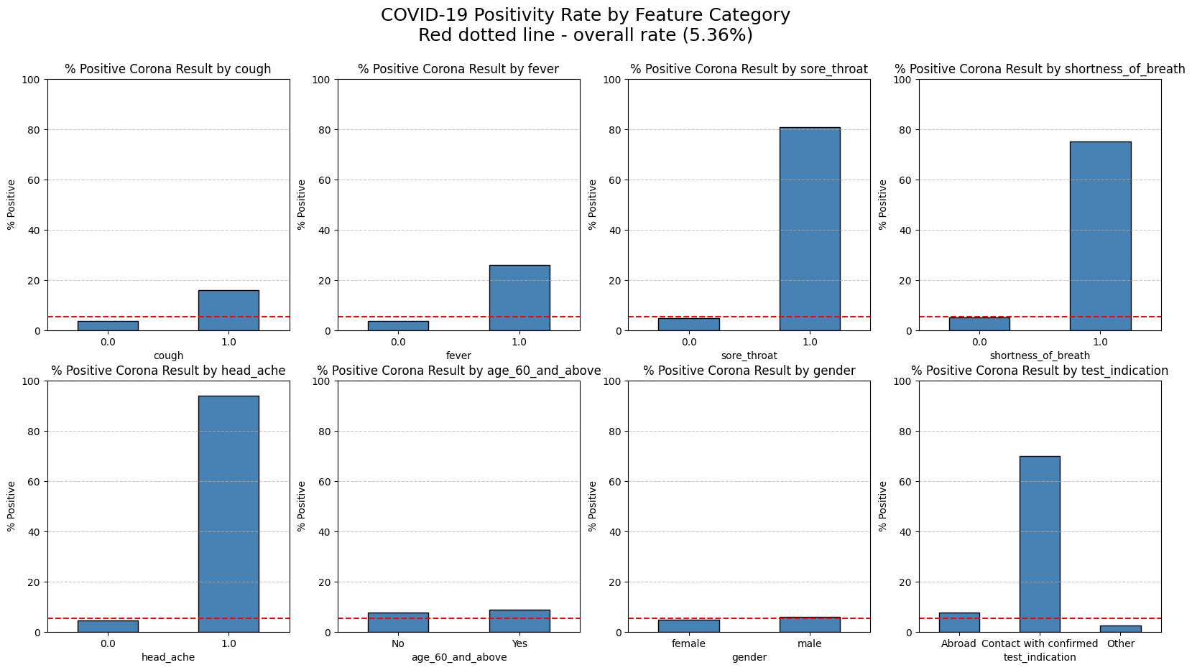
Exploratory Data Analysis
Imbalanced target: ~5% positive cases.
Some features have much higher rate based on positive value; sore_throat, shortness_of_breath, head_ache, test_indication.
One feature age_60_and_above had high null values: ~46%.

Slide 3
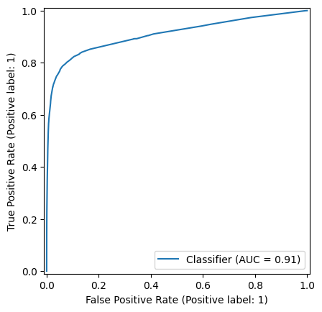
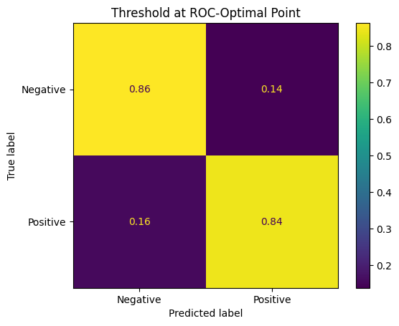
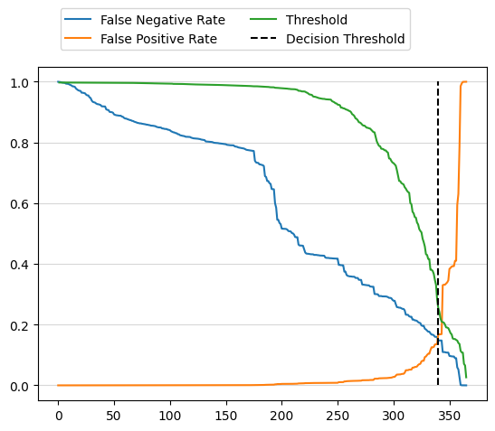
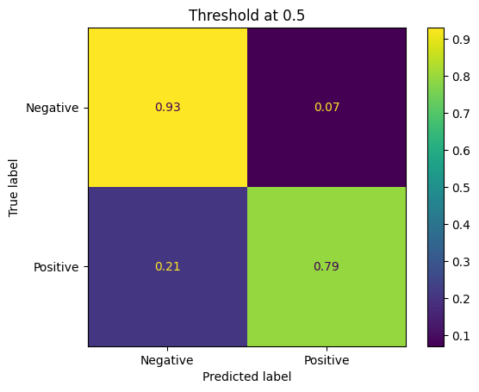
LightGBM
Preprocess:
Drop corona_result=“other”.
Drop test_date column.
corona_result: bool
All other cols: category. Model handles NaN, so kept in.
Train/test splits; stratify to keep imbalance.
Train using ROC-AUC metric.
Want to find a threshold for probabilities to minimise false negatives, also important to minimise false positives.
Chose threshold where false neg becomes less than false pos. False pos start to increase steeply on further reduction of false neg.
Comparing to threshold of 0.5 we see the increase of false neg.

Slide 4
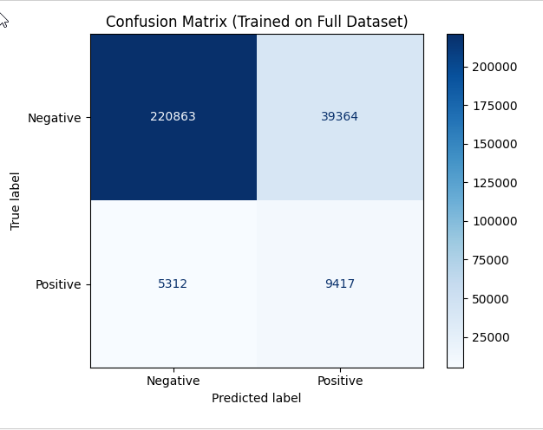
COVID-19 Screening Using Symptom Data
Problem Framing and Objective
Screening COVID-19 using self-reported symptoms to prioritize individuals for further testing or care.
Class Imbalance Challenge
Only 5.4% positive cases create difficulty in model training and evaluation due to data imbalance.
Modeling Approach
Logistic Regression chosen for interpretability and probabilistic outputs aiding healthcare decision-making.
Model Purpose and Use
Designed as a screening tool to flag potential cases, not for definitive diagnosis.

Slide 5
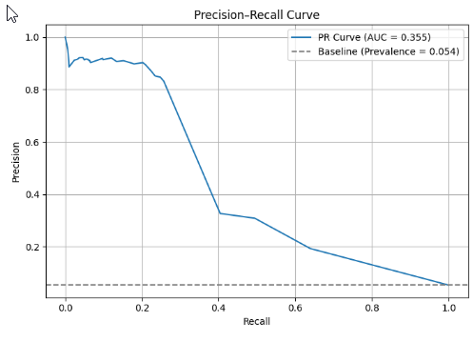
Handling Class Imbalance Effectively
Preprocessing for Imbalanced Data
Target labels were cleaned and encoded into consistent binary format for accurate modeling. Feature selection focused on realistic symptom indicators available during screening.
Limitations of Accuracy Metric
Accuracy is misleading for imbalanced data as it may favor the dominant class while ignoring minority positives. Alternative metrics are necessary.
Use of Precision, Recall, and F1 Score
Evaluation focused on precision, recall, and F1-score to balance identifying positive cases with minimizing false alarms in classification.
PR-AUC as Primary Metric
PR-AUC was chosen for its suitability in ranking positive cases above negatives, with baseline reflecting positive class prevalence

Slide 6
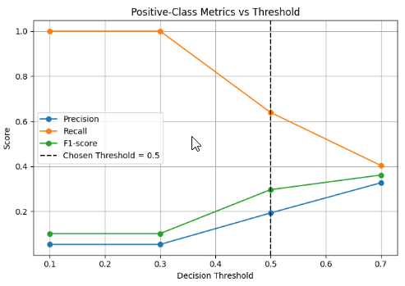
Final Outcome and Threshold Evaluation
Threshold Evaluation
Multiple thresholds were evaluated to balance recall and precision in logistic regression outputs.
Selected Threshold Rationale
Threshold 0.5 was chosen as the operational point, balancing recall of 64% with precision of 19%.
Model Effectiveness
The model's PR-AUC exceeded baseline prevalence, confirming meaningful symptom data signal capture.
Visual Decision Support
Precision, recall, and F1-score are plotted to clarify the threshold selection to stakeholders.

Slide 7
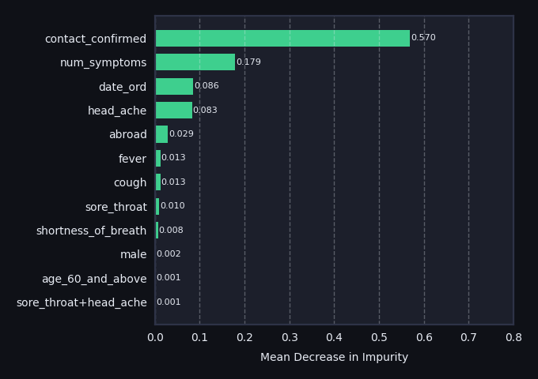
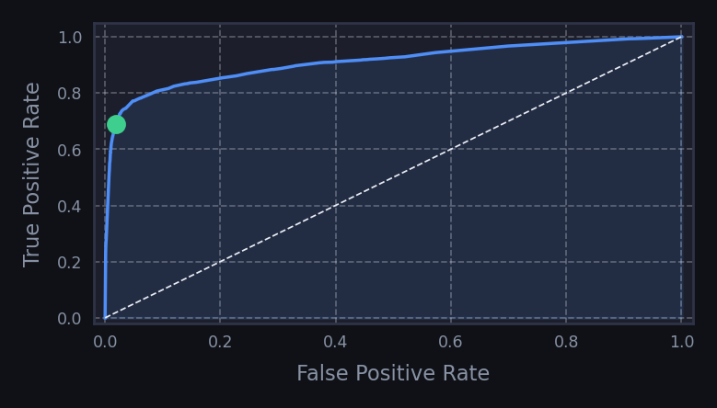
Model: Random Forest Classifier
COVID-19 Diagnosis Prediction | L7 Hackathon
PERFORMANCE METRICS
MODEL PARAMETERS
FEATURES & PRE-PROCESSING
Tuned via RandomizedSearchCV with StratifiedKFold (3 splits) with 35 iterations
Symptoms – Raw Boolean values
0.9102
cough, fever, sore_throat, shortness_of_breath, head_ache
criterion
entropy
max_depth
11
Demographic - Filled nulls
ROC-AUC | 55k Test Set | 0.25 Decision Threshold
age_60_and_above, male
max_features
18 (of 21)
Test Date - Converted to ordinal integer
0.680
0.682
0.685
0.679
n_estimators
25
date_ord
PR-AUC
F1 Score
Recall
Precision
min_samples_leaf
9
Indicators - Extracted confirmed contact and abroad status
contact_confirmed, abroad
CONFUSION MATRIX
min_samples_split
9
 | Predicted Negative | Predicted Positive
Actual Negative | True Negative 51,090 | 92.90% | False Positive 956 | 1.74%
Actual Positive | False Negative 928 | 1.69% | True Positive 2,018 | 92.9%
min_impurity_decrease
0.00015
Symptom Combinations - Boolean values for each combination and a count of total symptoms
min_impurity_decrease
0.00015
num_symptoms, 10x combinations of symptom features
RSCV Best Score on Training Data
0.9707
FEATURE IMPORTANCE
WAYS TO IMPROVE
With only 105 iterations of the random search, these parameters work well but further searching (or a full grid search) would be useful to determine if they are the best model configuration.
ROC CURVE
Whilst the training dataset is large at 219k samples, there is more data available which could be used to increase both the test and train dataset, or to use as an unseen validation dataset.
0.25 threshold
Feature engineering: The symptom combinations were not useful for the model’s predictive power and could likely be removed to reduce the complexity. Instead, I would try adding to the training data using external features. One idea is to try to capture the seasonality of illness, through use of daily temperature data.
AUC = 0.910
The symptom combination features are not shown as these resulted in an importance less than or equal to 0.001.

Slide 8
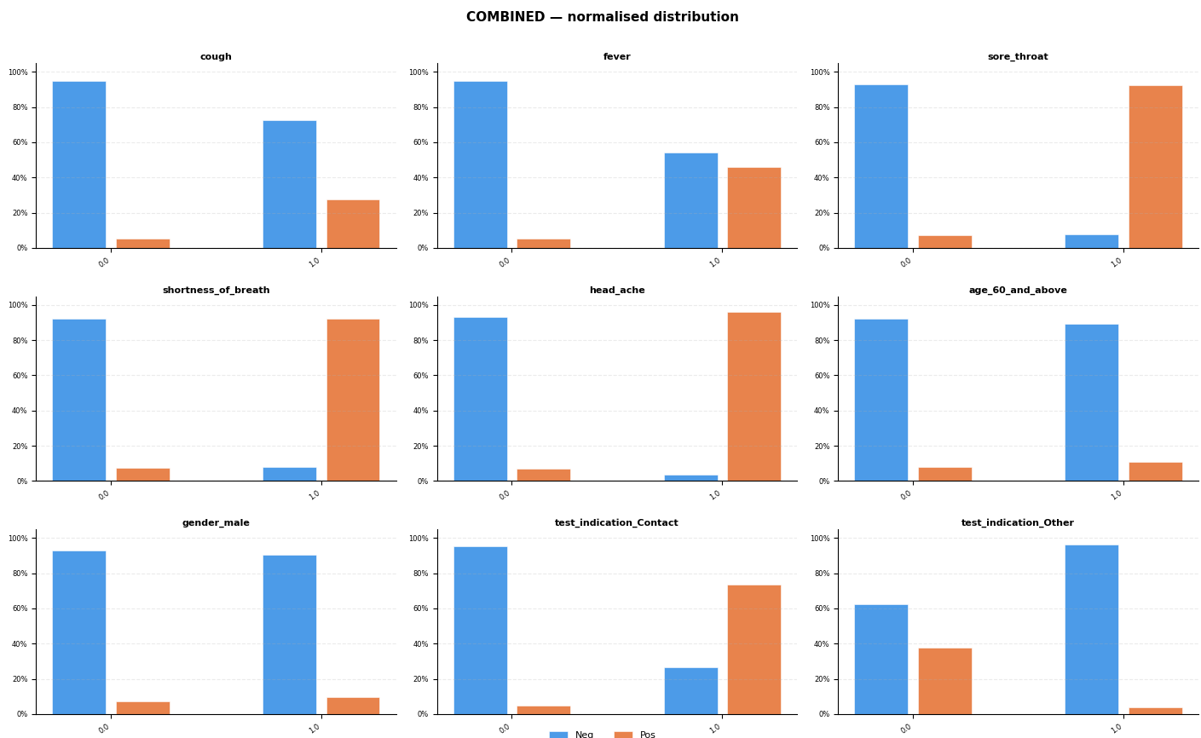
XGBOOST
Data cleaning approach similar to paper :
Training data contains all occurrences from 22/03/2020 to 31/03/2020 (51814 data points)
Test data contains all occurrences from 01/04/2020 to 07/04/2020 (47175 data points)
All NaN dropped for XGBOOST
Hot encoding of ‘test_indication’ feature = [‘Other’, ‘Abroad’, ‘Contact’]
9 features in total : Cough, Fever, sore_throat, shortness_of_breath, head_ache, age_60_and_above, gender_male, test_indication_Contact, test_indication_Other

Slide 9
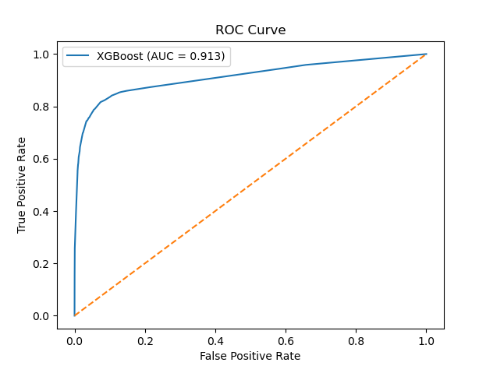
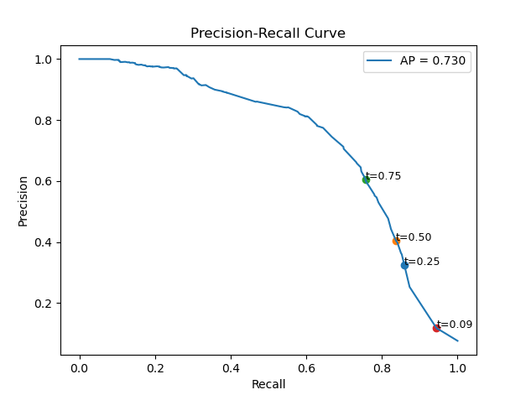
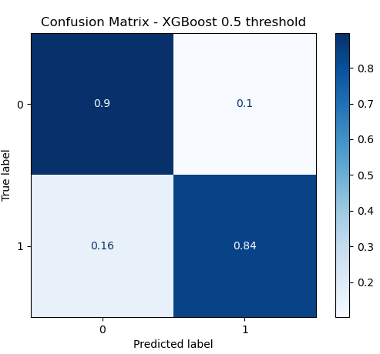
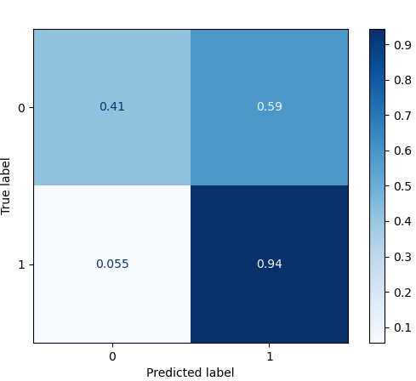
XGBOOST
Hyperparameters tunning with random search
Ran with 3 stratifiedKfold to optimise roc_auc score
ROC AUC score achieved of 0.913 similar to paper 0.9
AUPRC score of 0.73 outperform paper (0.66)
Model is highly sensitive to threshold selection with a trade-off between recall and precision as shown in the PR curve
Lower threshold will increase recall (up to 0.94) which can be desirable for medical screening where missing positive cases is undesirable.
However precision reduces significantly with higher False positive 59%.
Confusion Matrix – XGBoost 0.09 threshold

Slide 10
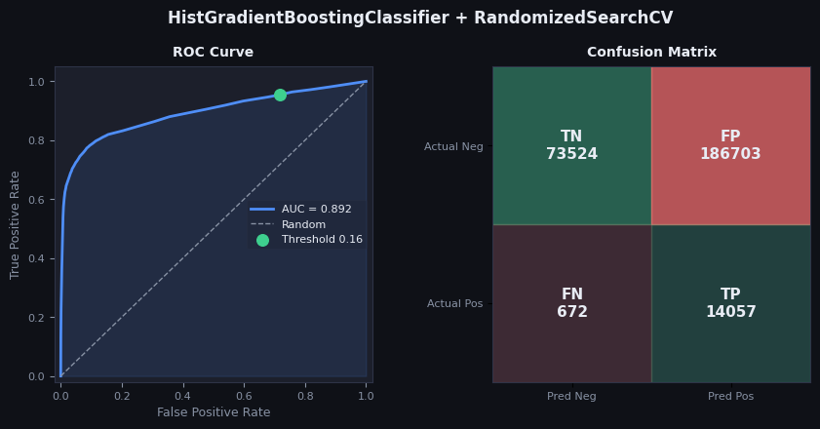
HistGradientBoostingClassifier
Notes:
My approach was to take use a randomised search to tune a HistGradientBoostingClassifier model. scikit-learn’s documentation suggests that, for datasets over ten thousand rows, a histrogram-based approach is computationally more efficient than for GradientBoostingClassifier. I trained on a StratifedKFold to use the entire dataset, but after hyperparameter tuning I refitted the best parameters using an out-of-fit cross-validation to prevent data-leakage but permit the whole dataset to be used. My AUC score was lowest of our group at 0.892, but still not far out.
Given the misleading nature of accuracy, I decided to focus solely on recall. I wrote a function to determine a desired threshold value based upon an intended recall target, here choosing 95%. This provided a more aggressive threshold of 0.162, which weights a false positive just over five times stronger than a false negative. This leads to an odd-looking confusion matrix with a very large number of false positives, but in the context of Covid screening I decided to absolutely prioritise this over accuracy and precision

Slide 11
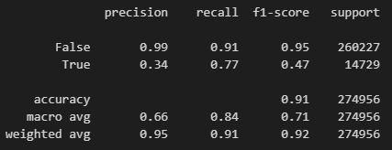
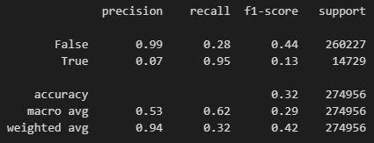
HistGBC Classification Report
Standard Threshold = 0.5
Threshold = 0.162
Notes:
This is the consequential impact on the respective classification reports. Even with a standard threshold precision in the true class is low, but is reduced further when prioritising recall. An alternative method could be to prioritise a f-beta score, for some beta greater than 1, to give some weight to retaining a level of precision.
It should be noted that any choice of threshold isn’t a strictly analytical problem, and indeed requires stakeholder input. While in this case we can assume that this screening is cost-neutral for prediction/outcome pair, tuning the threshold depends on balancing the consequences of lower precision and recall scores. Choosing any arbitrary threshold thus doesn’t doesn’t change the ROC curve or the area under the curve, only at what probability level True is assigned.
HistGBC, as with many tree models in unsupervised learning, does have a habit of trying to push confident predictions towards extreme values. I therefore experimented with CalibratedClassifierCV, which aims to calibrate the probabilities back to something more meaningful to a stakeholder.

Slide 12
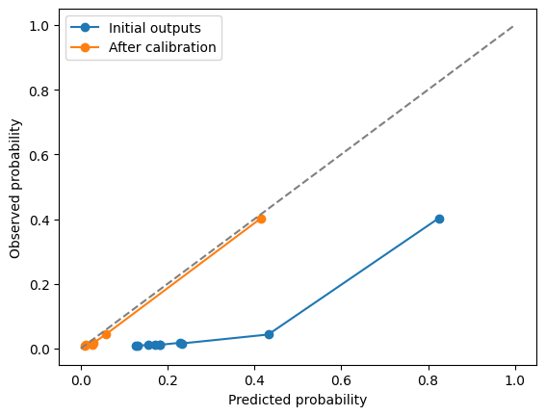
Calibrated HistGBC Model
Notes:
Given the previously generated out-of-fold probabilities of the True class by the model, this chart demonstrates that the model is generally over-predicting the instances of true cases. An example is how frequently the model assigns probabilities in the range 0.4-0.8 to the True class, when the observed positive rates in that rate are closer to the range of 0.05-0.4.
This converts the probabilities into something more interpretable to the stakeholder, so that a predicted model probability of 0.25 now means that “approximately 1 in 4 cases that have similar characteristics returned a positive test”. This calibration acts independently of the model performance via area under curve score.

Slide 13
Summary
Model | ROC-AUC | PR-AUC | False Neg | False Pos | Threshold
LightGBM | 0.910 | 0.684 | 16% | 14% | 0.26
LightGBM | 0.910 | 0.684 | 21% | 7% | 0.5
Logistic Regression | 0.768 | 0.355 | 15% | 36% | 0.5
Random Forest | 0.910 | 0.68 | 31.3% | 1.90% | 0.25
XGBoost | 0.913 | 0.73 | 5.5% | 59% | 0.09
XGBoost | 0.913 | 0.73 | 16% | 10% | 0.5
HistGBC | 0.892 |  | 0.24% | 66.95% | 0.162
All models performed relatively similarly.
Higher difference in performance was through choice of threshold value.
All are a balance of reducing false negative which is the most important as you don’t want to miss cases, while not flagging too many false positives which would create tests for negative cases.

